Slide 1
12 End-User-Friendly Explanatory Forms Prototype Design Template based on EUCA: End-User-Centered Explainable AI Framework
Website: http://weinajin.github.io/end-user-xai Created by Weina Jin (Email: weinaj at sfu dot ca)

Slide 2
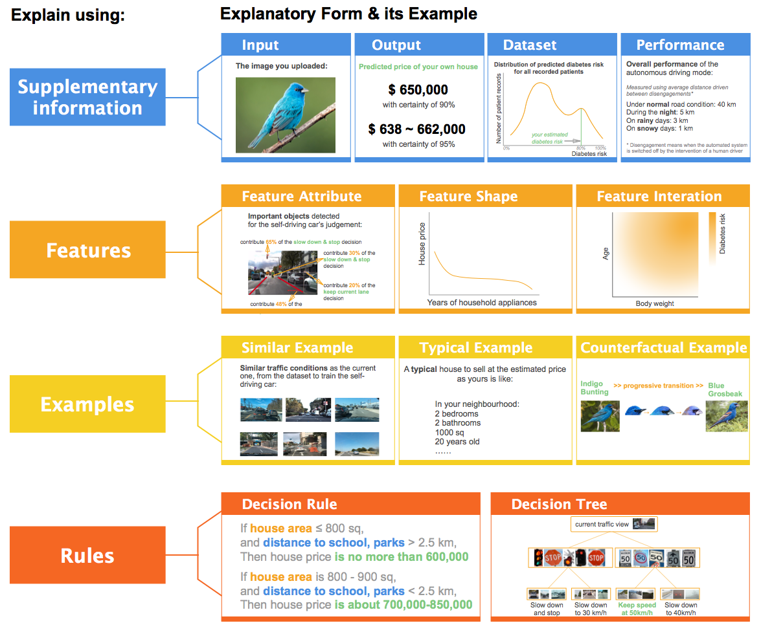

Slide 3
1. Supplementary Information 1.1 Input 1.2 Output 1.3 Dataset 1.4 Performance

Slide 4
The features of your current input:
Feature 1
Feature 2
Feature 3
……

Slide 5
The features of your own house
2 bedrooms
1 bathroom
780 sq
20 years old
household appliances for 10 years
distance to school, parks: 2 km

Slide 6
The data from your health records used for prediction:
Male, 33 years old
Three consecutive blood sugar level: normal, normal, higher than normal
Body weight: 75 kg, height 175 cm
Calories intake per day: 3200
Minutes of exercise per week: 50 min
Family history of diabetes: ……
......

Slide 7
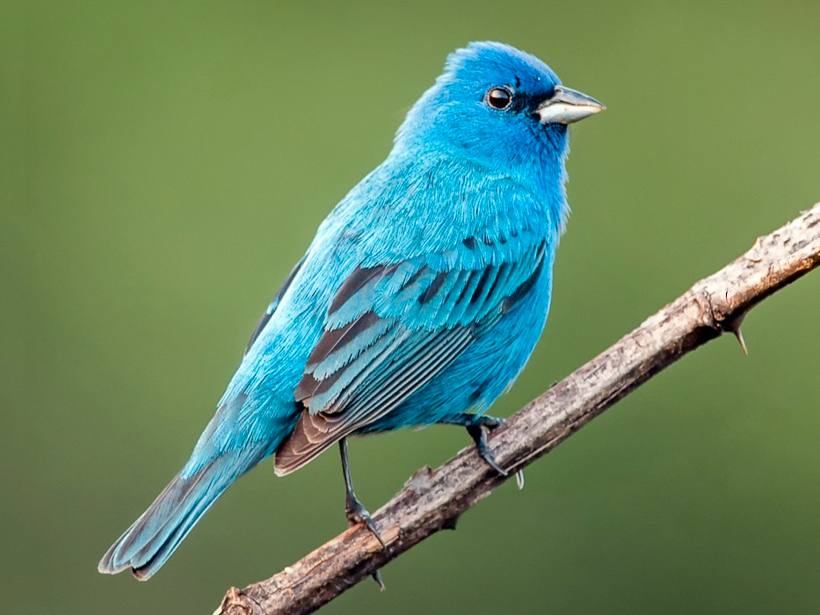
The image you uploaded:

Slide 8
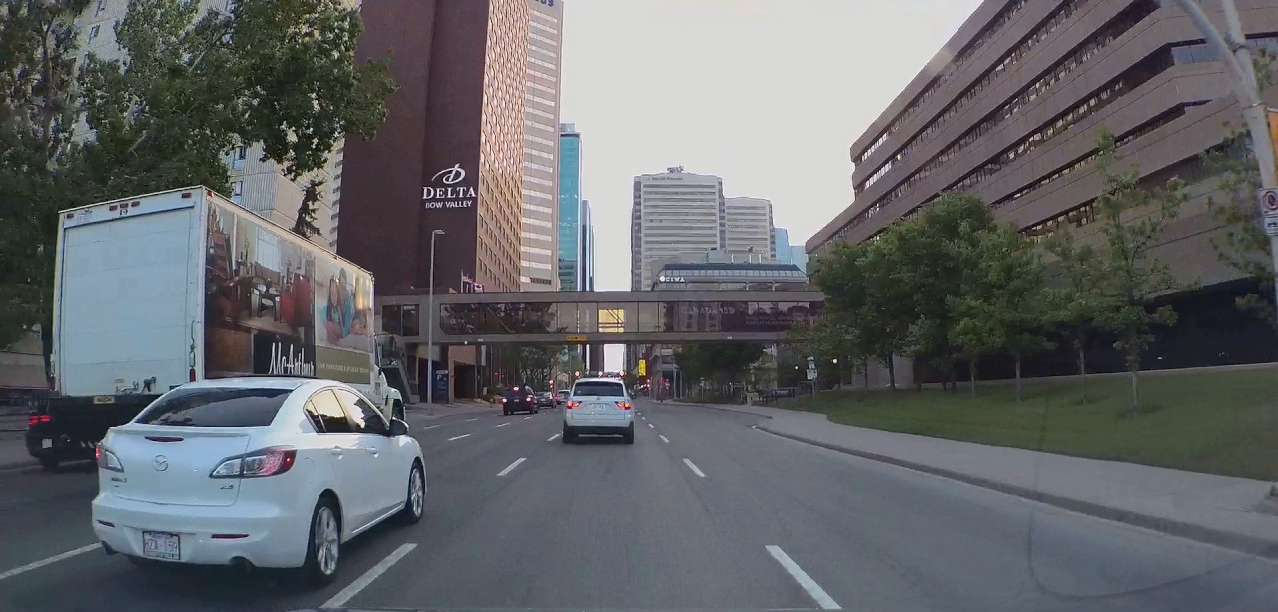
Current traffic view:

Slide 9
1. Supplementary Information 1.1 Input 1.2 Output 1.3 Dataset 1.4 Performance

Slide 10
AI’s Decisions:
Confidence
Decision 1
95%
Decision 2
95%
Decision 3
55%

Slide 11
The current decisions, and their percentage in the training dataset where the AI learns from
Confidence
95%
Precentage
Decision 1
25%
Decision 2
95%
34%
Decision 3
55%
2.9%

Slide 12
Your chance of getting diabetes within the next year is:
80 %

Slide 13
Predicted price of your own house
$ 650,000

Slide 14
80 %
with a certainty of 90%
Your chance of getting diabetes within the next year is:
75 ~ 85%
with a certainty of 95%

Slide 15
$ 650,000
with certainty of 90%
Predicted price of your own house
$ 638 ~ 662,000
with certainty of 95%

Slide 16
The image you uploaded is recognized as:
Likelihood
Indigo Bunting
95%
Blue Grosbeak
70%
Lazuli Bunting
55%

Slide 17
Driving decisions under the current traffic:
Confidence
Keep straight
95%
Keep speed at 50 km/h
95%
Right lane change
55%

Slide 18
The three most likely bird according to your uploaded image, and their percentage in the training dataset where the AI learns from
Likelihood
Precentage
Indigo Bunting
95%
1.5%
Blue Grosbeak
70%
1.2%
Lazuli Bunting
55%
1.3%

Slide 19
The current driving decisions, and their percentage in the training dataset where the self-driving car learns from
Confidence Precentage
Keep straight
95%
25%
Keep current speed | 95% | 34%
Right lane change | 55% | 2.9%

Slide 20
1. Supplementary Information 1.1 Input 1.2 Output 1.3 Dataset 1.4 Performance

Slide 21
Distribution of house prices
Number of data
estimated price of your house
House prices

Slide 22


Distribution of house prices
Number of data
estimated price of your house
House prices

Slide 23
Distribution of predicted diabetes risk
for all recorded patients
Number of patient records
your estimated diabetes risk
0%
80% 100%
Diabetes risk

Slide 24
Distribution of predicted diabetes risk
for all recorded patients
5% of all the records are within the range of your estimated risk
Number of patient records
your estimated diabetes risk
0%
80% 100%
Diabetes risk

Slide 25
1. Supplementary Information 1.1 Input 1.2 Output 1.3 Dataset 1.4 Performance

Slide 26
Overall performance of the AI :
Accuracy: 85%
Error rate: 15%

Slide 27
Overall performance of the AI bird recognition tool:
Accuracy: 85%
Error rate: 15%

Slide 28
Overall performance of the autonomous driving mode:
Measured using average distance driven between disengagements*
Under normal road condition: 40 km
During the night: 5 km
On rainy days: 3 km
On snowy days: 1 km
* Disengagement means when the automated system is switched off by the intervention of a human driver

Slide 29
The performance of the AI tool to predict diabetes risk
Mean prediction error: ± 15%
Max prediction error: ± 30%
The AI tool can explain 75% of the variation in the training data

Slide 30
The performance of the AI house precdiction tool
Mean prediction error: ± 50,000
Max prediction error: ± 120,000
The AI tool can explain 95% of the variation in the training data

Slide 31
2. Feature-based explanation 2.1 Feature Attribute 2.2 Feature Shape 2.3 Feature Interaction

Slide 32
How important is each feature to the result:
Feature 1
Feature 2
Feature 3
Feature 4
Feature 5
Feature 6

Slide 33
How important is each feature to the result:
House area Distance to school, parks Accessible to transportation
Number of rooms
Age of house Local crime rate

Slide 34
Feature importance score
House area Distance to school, parks
Accessible to transportation
Number of rooms
Age of house Local crime rate

Slide 35
How important is each feature to the result:
Blood sugar level
Age Body weight
Calories intake per day
Minutes of exercise per week Family history of diabetes

Slide 36
Feature importance score
Blood sugar level
Age Body weight
Calories intake per day
Minutes of exercise per week
Gender

Slide 37
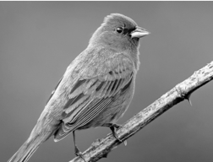


Important regions (highlighted) for AI’s bird recognization:

Slide 38
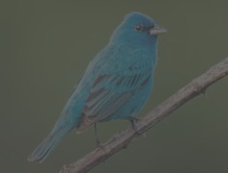

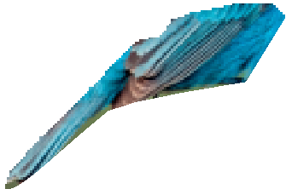
Important regions (highlighted) for AI’s bird recognization:
contribute 30% of the overall decision
contribute 20% of the overall decision

Slide 39
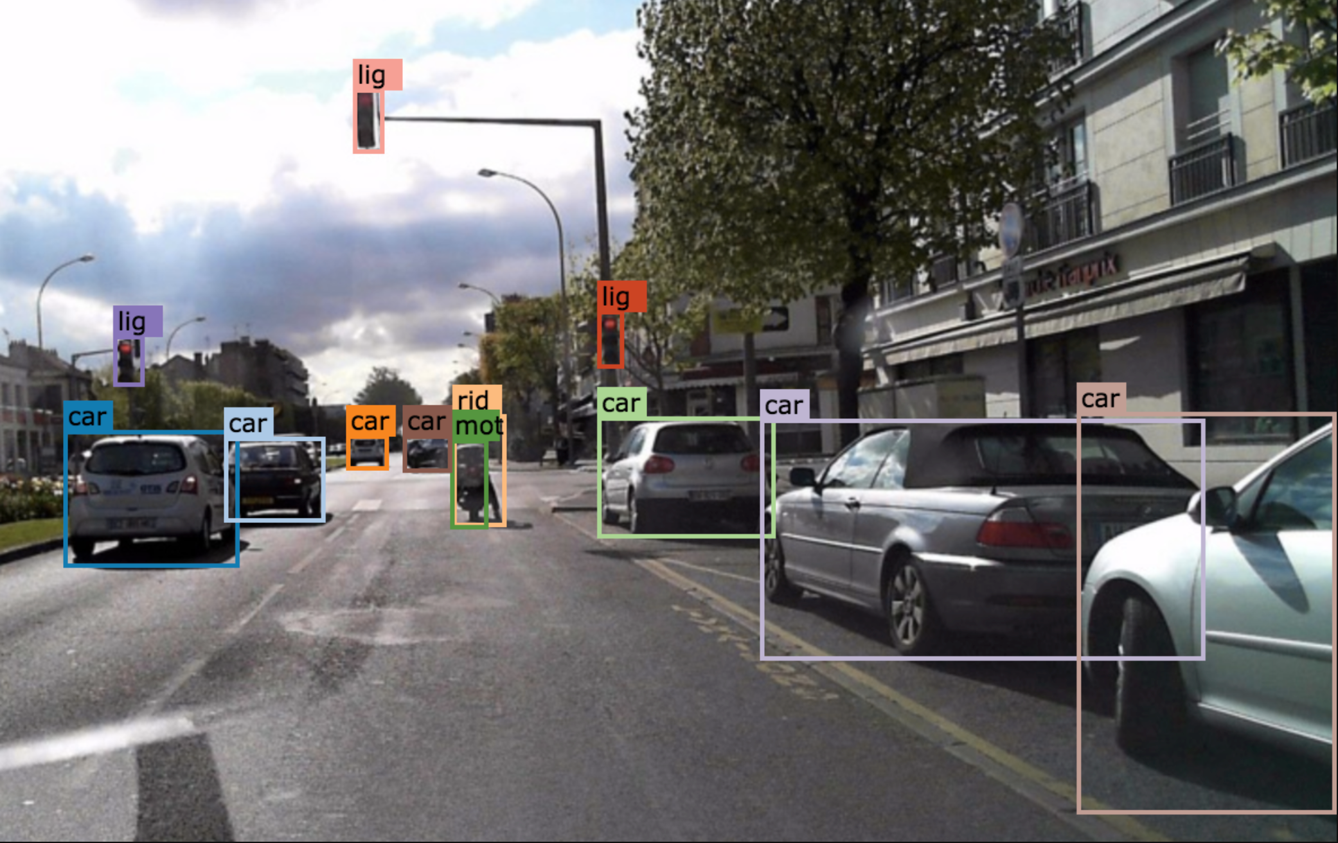
Important objects detected
for the self-driving car’s judgement:
lane marking

Slide 40
Important objects detected
for the self-driving car’s judgement:
contribute 65% of the slow down & stop decision
contribute 30% of the slow down & stop decision
contribute 20% of the keep current lane decision
lane marking
contribute 48% of the
keep current lane decision

Slide 41
2. Feature-based explanation 2.1 Feature Attribute 2.2 Feature Shape 2.3 Feature Interaction

Slide 42
Prediction
Your input data is here:
value
Feature 1

Slide 43
House price
Yours is here: 10 years
Years of household appliances

Slide 44
House price
Your house is here: 780 sq
House area

Slide 45
Diabetes risk
Your exercise data is here: 50 min/week
Minutes of exercise per week

Slide 46
Diabetes risk
Body weight

Slide 47
2. Feature-based explanation 2.1 Feature Attribute 2.2 Feature Shape 2.3 Feature Interaction

Slide 48


Prediction scale
Feature 2
Your input is here: Feature 1: value
Feature 2: value Prediction: value
Feature 1

Slide 49
Diabetes risk
Age
Your data is here: Age: 33
Weight: 75 kg
Diabetes risk: 80%
Body weight

Slide 50


Number of rooms
House price
Your house is here: Area: 780 sq
Rooms: 3
Price: 650,000
House area

Slide 51
3. Example-based explanation 3.1 Similar Example 3.2 Typical Example 3.3 Counterfactual Example

Slide 52
A similar example as your input is like:
Feature 1
Feature 2
Feature 3
Feature 4
Feature 5
Feature 6
Prediction:

Slide 53
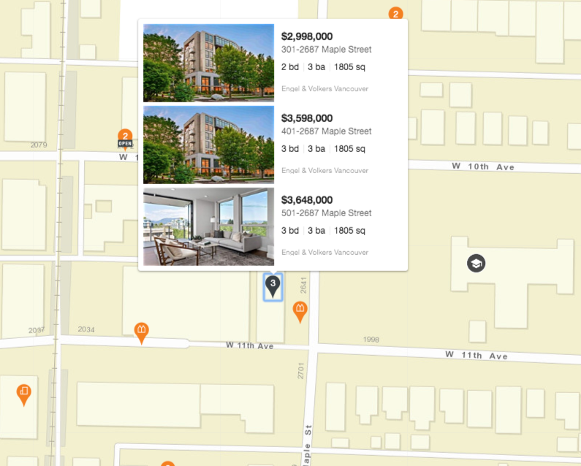
The houses of similar features as yours

Slide 54
A similar case as yours is like:
Male, 35 years old
Three consecutive blood sugar level: normal, normal, higher than normal
Body weight: 81 kg, height 183 cm
Calories intake per day: 3400
Minutes of exercise per week: 60 min
Family history of diabetes: ……
Diabetes risk: 82%

Slide 55
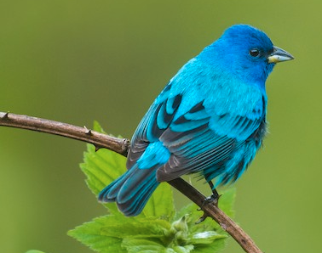
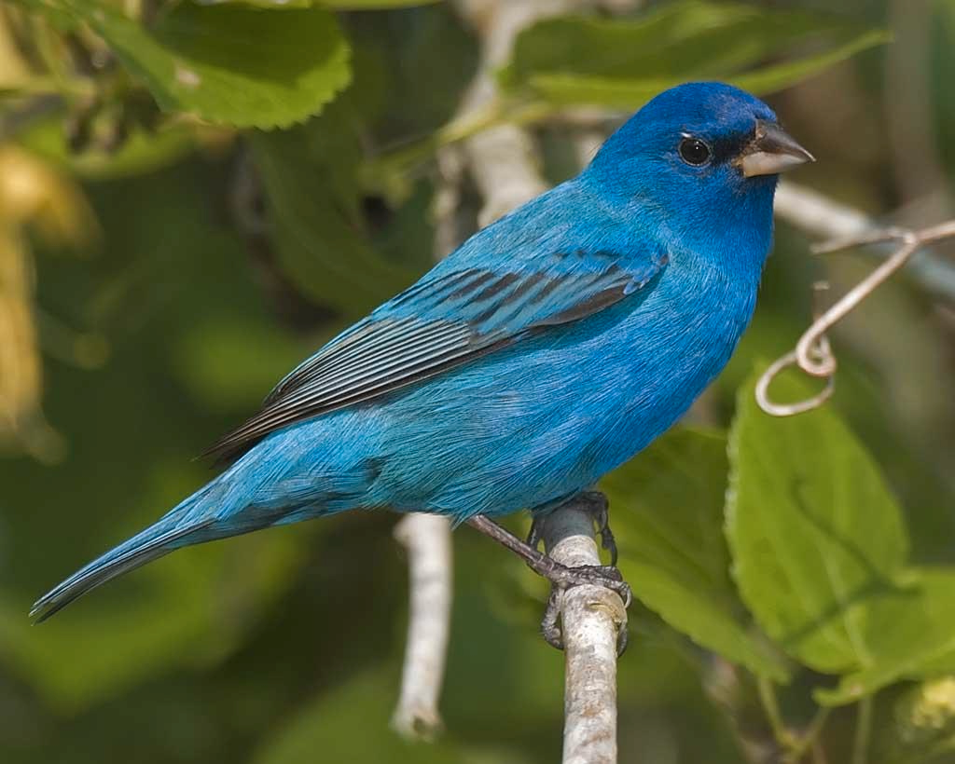
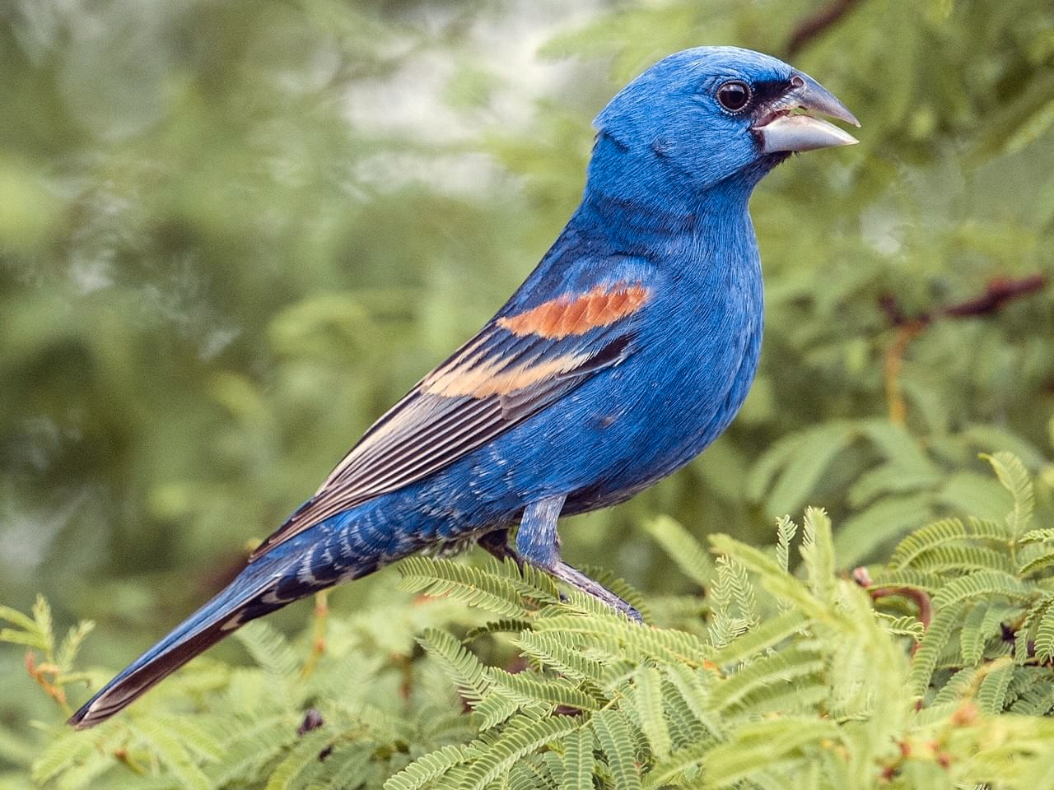
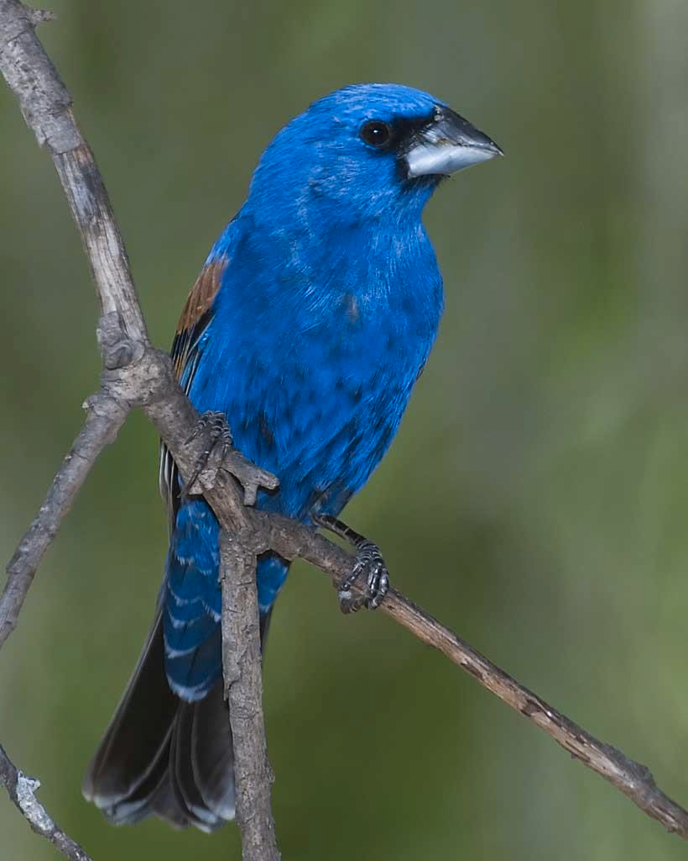
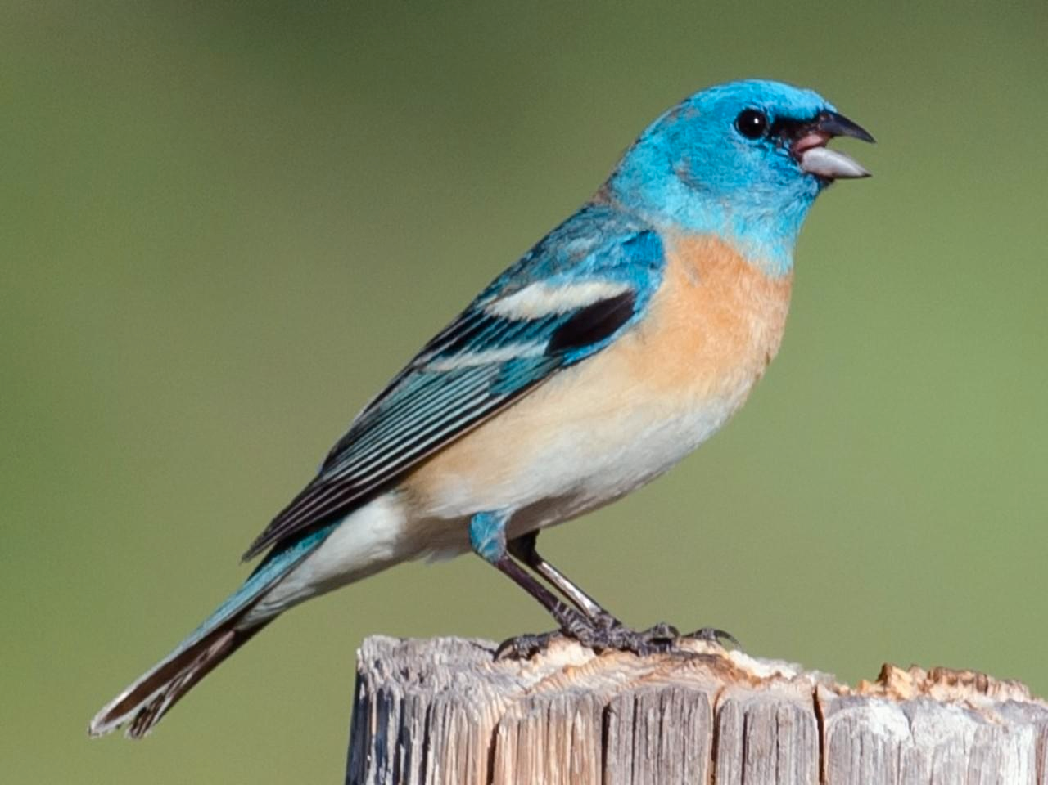
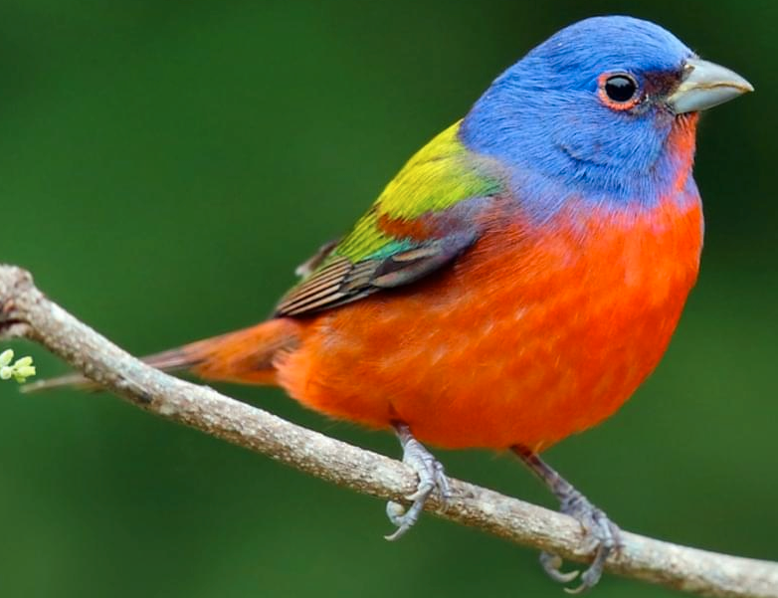
Similar images to the one you uploaded:
Indigo Bunting 95%
Indigo Bunting 95%
Blue Grosbeak 70%
Blue Grosbeak 70%
Lazuli Bunting 55%
Painted Bunting 45%

Slide 56
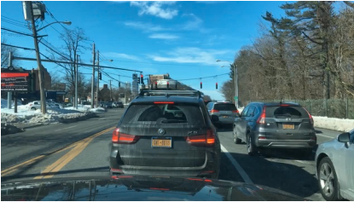
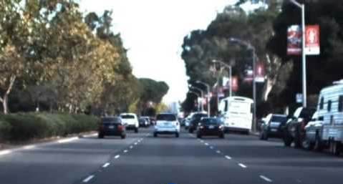
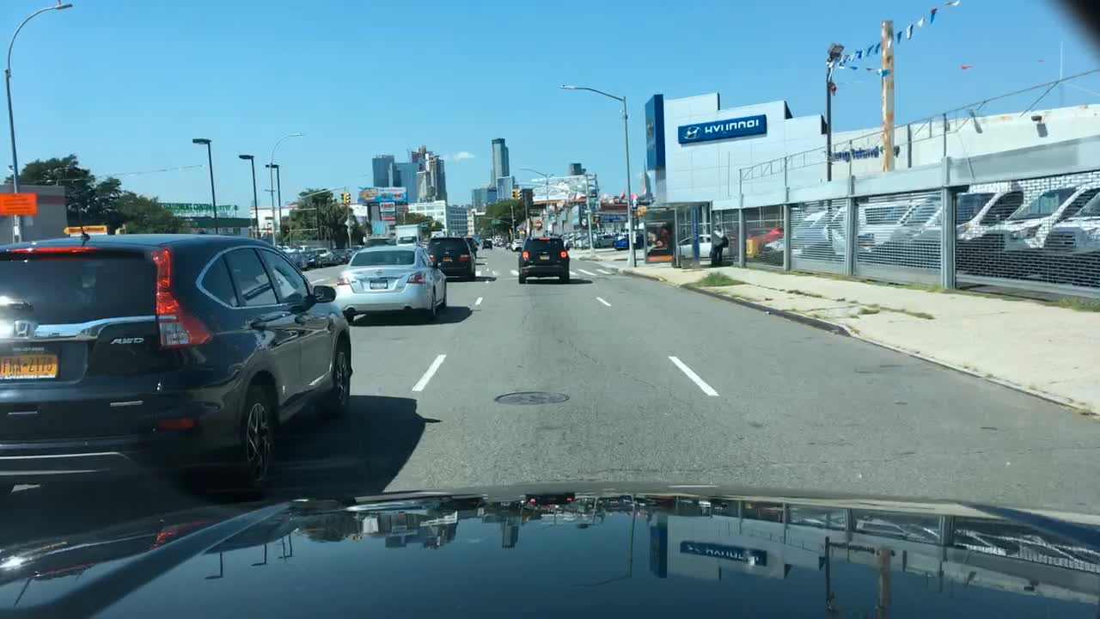
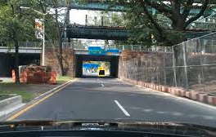
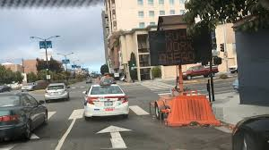
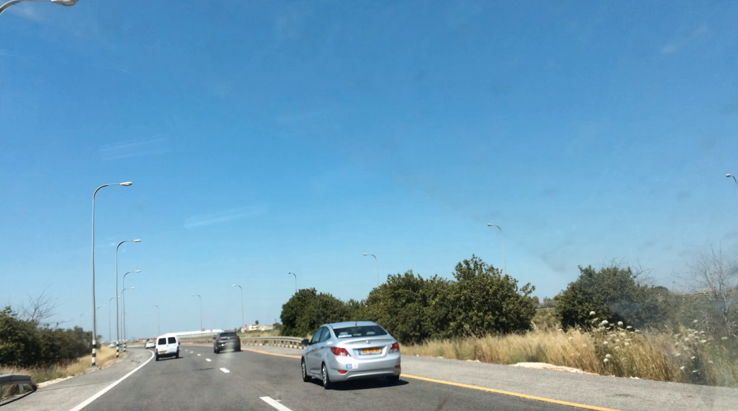
Similar traffic conditions as the current one, from the dataset to train the self- driving car:

Slide 57
3. Example-based explanation 3.1 Similar Example 3.2 Typical Example 3.3 Counterfactual Example

Slide 58
A typical example of the same prediction as yours (prediction value) is like:
Feature 1
Feature 2
Feature 3
Feature 4
Feature 5
Feature 6

Slide 59
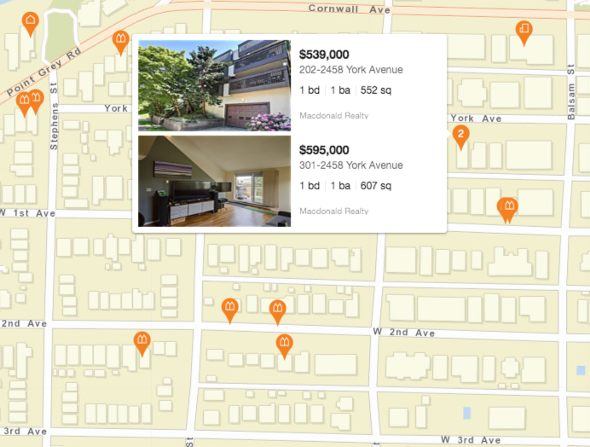
The houses of similar price as yours

Slide 60
A typical case of the same diabetes risk as yours (80%) is like:
Male, 45 years old
Three consecutive blood sugar level: normal, normal, higher than normal
Body weight: 78 kg, height 175 cm
Calories intake per day: 3000
Minutes of exercise per week: 30 min
Family history of diabetes: ……
......

Slide 61
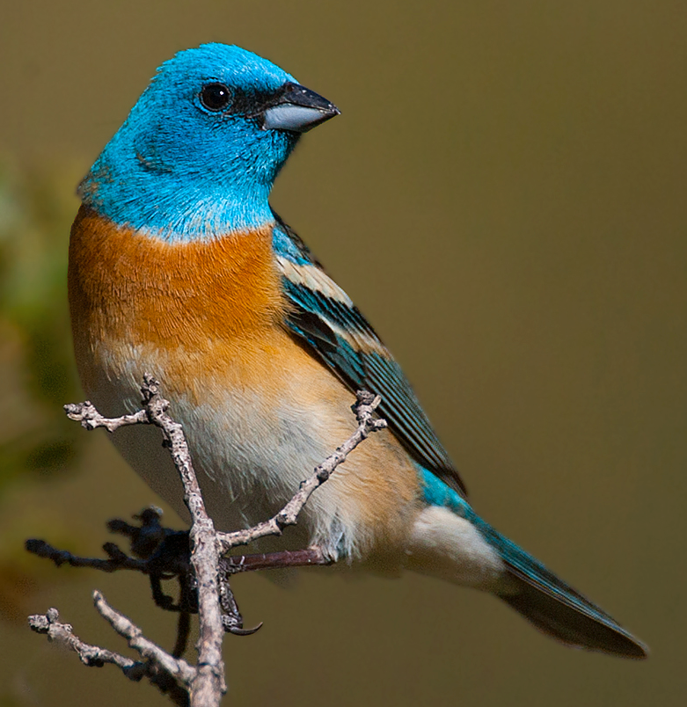
The three most likely bird according to your uploaded image, and typical examples
Indigo Bunting 95%
Blue Grosbeak 70%
Lazuli Bunting 55%

Slide 62
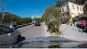
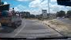
Typical traffic conditions to reach the self-driving car’s current decison:
Keep straight 95%
Keep current speed
70%
Right lane change 55%

Slide 63
3. Example-based explanation 3.1 Similar Example 3.2 Typical Example 3.3 Counterfactual Example

Slide 64
If one of your input features had changed to the following value, your predicted outcome would have increased by 20%:
Feature 1 changed to some value
Feature 2 changed to some value
Feature 3 changed to some value
Feature 4 changed to some value
Feature 5 changed to some value
Feature 6 changed to some value
……

Slide 65
If the feature of your house had changed to the following feature,
your house would have increased 10% of the estimated value
have a back yard, or
3 bathrooms, or
1200 sq, or
less than 10 years old, or
has new household appliances
……

Slide 66
If your health data had changed to the following, your diabetes risk would have decreased by 20%:
3 years younger than now
Body weight: loss 5 kg
Increase 50 min of weekly exercise
Reduce 500 calories of daily
calories intake
……

Slide 67
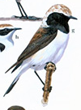

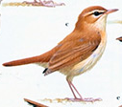


highlight different regions Bird B
Bird A

Slide 68
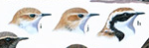
>> progressive transition >> Bird B
Bird A

Slide 69
4. Rule-based explanation 4.1 Decision Rules 4.2 Decision Tree 4.3 Decision Flowchart

Slide 70
If feature 1 ≤ some value, and feature 2 > some value,
Then the prediction is some value
If house area is some value,
and distance to school, parks < some value,
Then the prediction is another value

Slide 71
If house area ≤ 800 sq,
and distance to school, parks > 2.5 km, Then house price is no more than 600,000
If house area is 800 - 900 sq,
and distance to school, parks < 2.5 km, Then house price is about
700,000-850,000

Slide 72
If blood sugar is high,
and body weight is overweight,
Then the estimated diabetes risk
is above 80%
If blood sugar is normal,
and body weight is overweight,
Then the estimated diabetes risk
is about 20-50%

Slide 73
If bird bill is small and thin, and wings and tails are short, Then the bird is recognized as Indigo Bunting
If bird bill is big and thick, and wings and tails are long, Then the bird is recognized as Blue Grosbeaks

Slide 74
If traffic sign is stop sign,
or the speed of the car in front are
slower,
Then the speed decision is to
slow down and stop
If traffic sign is 50km/h speed limit, and the speed of the car in front are the same or faster,
Then the speed is kept at
50km/h

Slide 75
distance to school, parks
house price prediction
house area
≤ 800 sq | > 2.5 km
≤ 800 sq | < 2.5 km
800-900 sq | < 2.5 km
Rule 1
Rule 2
Rule 3
< 600,000
600,000-
700,000
700,000-
850,000

Slide 76
body weight
blood sugar
diabetes risk
high | high
high | normal
normal | normal
Rule 1
> 80%
50-80%
Rule 2
< 20%
Rule 3

Slide 77
4. Rule-based explanation 4.1 Decision Rules 4.2 Decision Tree 4.3 Decision Flowchart

Slide 78
Feature 1
<cutoff value of feature 1
>cutoff value of feature 1
Feature 2
Feature 2
<cutoff value of feature 2
Prediction 1
>cutoff value of feature 2
Prediction 2
<cutoff value of feature 2
Prediction 3
>cutoff value of feature 2
Prediction 4
Estimated prediction

Slide 79
≤ 800 sq 800-900 sq
house area
distance to school, parks
distance to school, parks
> 2.5 km < 2.5 km
< 2.5 km > 2.5 km
< 600,000
600,000-
700,000
700,000-
850,000
550,000-
700,000
house price prediction

Slide 80
normal
Blood sugar
high
Body weight
Body weight
normal overweight normal overweight
< 20% 20-50% 50-80% >80%
Estimated diabetes risk

Slide 81
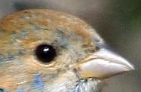
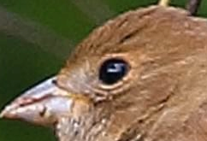
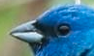
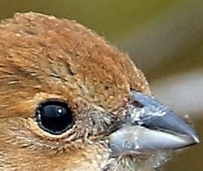
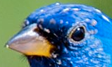
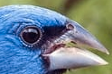
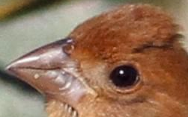
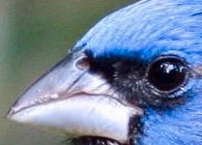
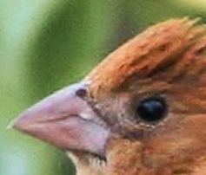
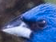
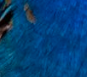
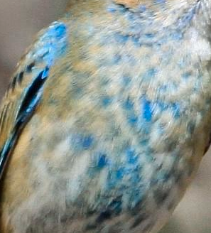
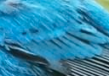
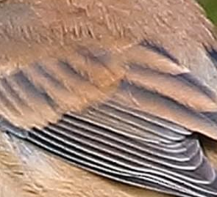
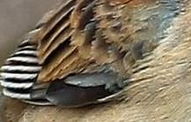
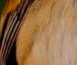
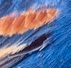
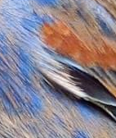

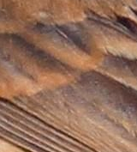
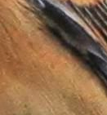
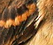
an uploaded image
Indigo Bunting, male
Indigo Bunting, female
Blue Grosbeak, male
Blue Grosbeak, female

Slide 82
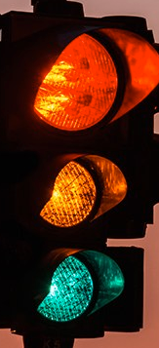
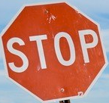




















current traffic view
Slow down and stop
Slow down to 30 km/h
Keep speed at 50km/h
Slow down to 40km/h

Slide 83
4. Rule-based explanation 4.1 Decision Rules 4.2 Decision Tree 4.3 Decision Flowchart

Slide 84
Input data
No
Feature 1
> some value
Prediction 1
Yes
Feature 2
< some value
No
Prediction 2
Yes
Prediction 3

Slide 85
A house to sell
No
house area
> 800 sq
house price 500,000-700,000
Yes
distance to school, parks
< 2.5 km
No
house price 550,000-700,000
Yes
house price 700,000 - 850,000

Slide 86
A patient’s health record
No
blood sugar is high
diabetes risk
< 50%
Yes
body weight overweighted
Yes
diabetes risk > 80%
No | diabetes risk 50-80%

Slide 87


an uploaded image
looks at head
house area
> 800 sq
looks at belly
reach a conclusion on the bird species

Slide 88


current traffic view
detected traffic sign
house area
> 800 sq
detected traffic objects
reach driving decisions

